Slide 1
Historical Foundations of Christianity
From Jesus to Paul
Monday Sept. 30, 2013
Osher Lifelong Learning Institute (OLLI)
The University of Alabama, Tuscaloosa
Larry Clayton, Instructor
Notes:
Many different levels of understanding in this Module. Principally divided between the historical facts and the theological teachings.

Slide 2
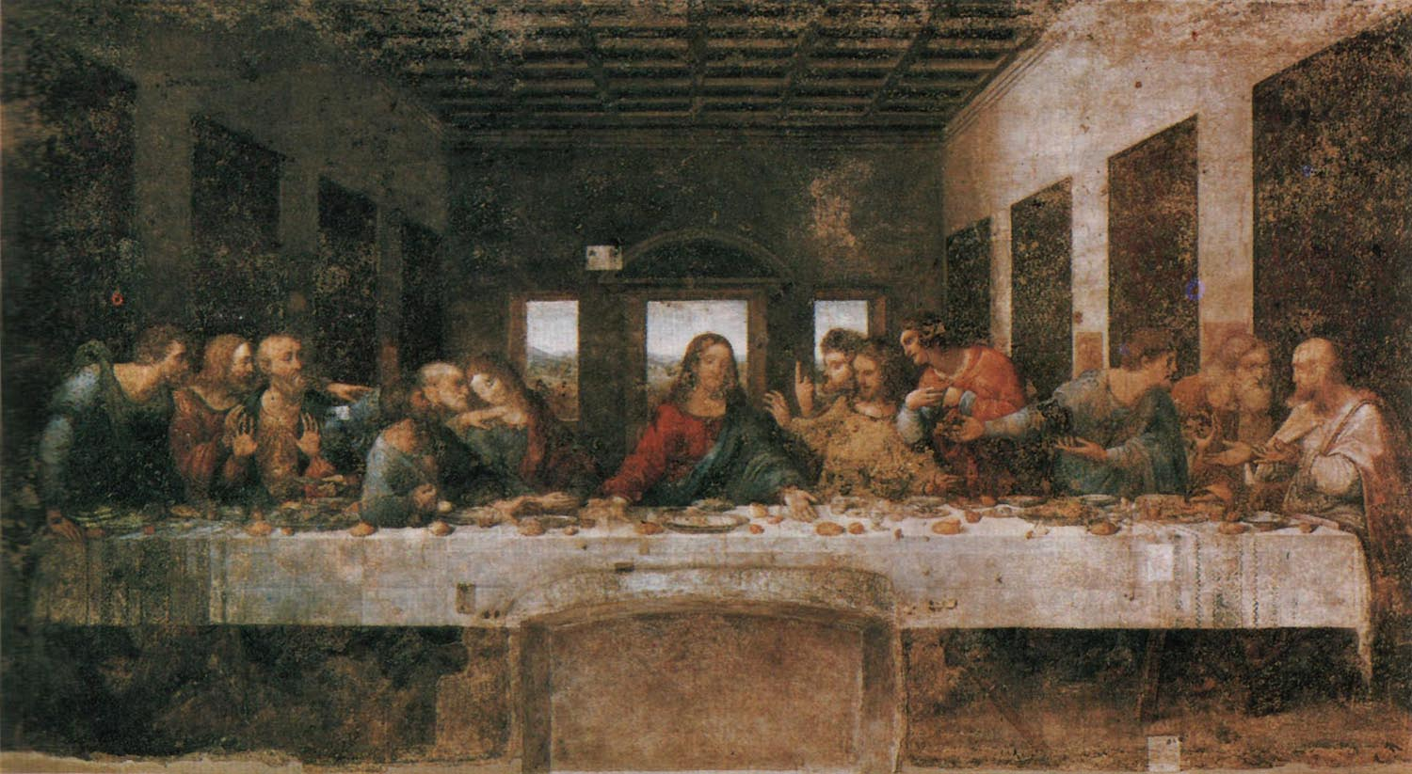
Crucifixion
Then, that last week in Jerusalem, Passion Week.
The Last Supper (Da Vinci)
A horrible turn
End of the journey
Arrest
Why did Jesus go to Jerusalem?
To face certain death?
Notes:
We left off Module Two with Jesus traveling to Jerusalem to celebrate the Passover meal. It turned into the most important week in the history of Christianity.

Slide 3
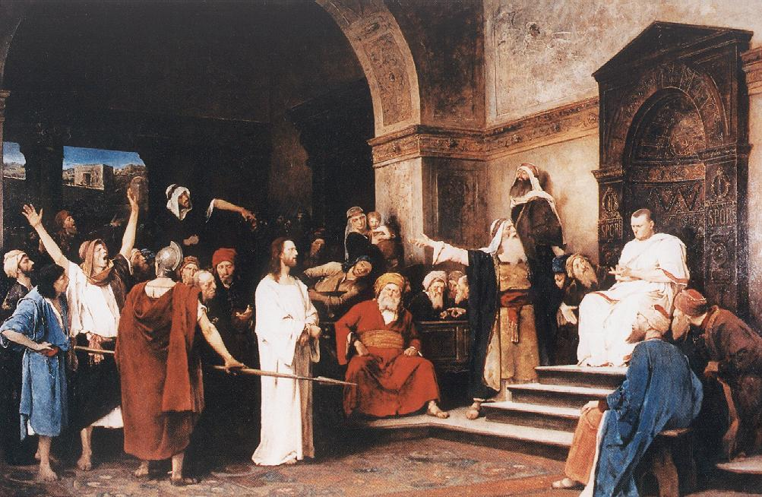
Crucifixion
Blasphemy, sacrilege, challenging the power structure.
Hearing by Pontius Pilate
No crime against Rome
Notes:
He was accused of [see above]. There was a hearing by P. Pilate who in his inquiry determined there was no crime against Rome.

Slide 4
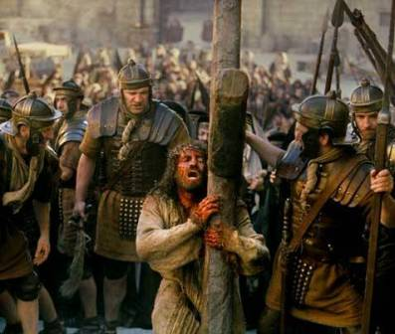
Crucifixion
Jesus obeys the will of God.
Fulfilling prophecy (Isaiah 52:13-53:12)
Suffering generally conferred power, in keeping with widespread Jewish belief.
Worthy is the Lamb (Brooklyn Tabernacle Choir) Flash forward moment, to modern Christianity.
Notes:
The general context of Jesus’s travel to Jerusalem. To fulfill prophecy and live out the prophecies. Then to flash forward moment.

Slide 5
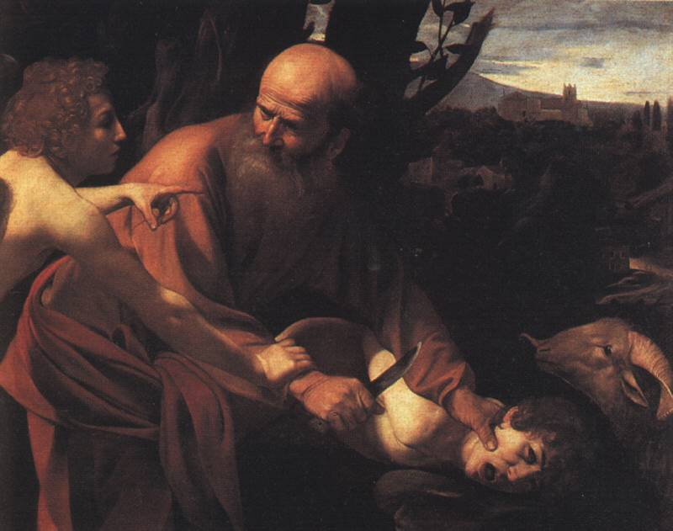
Crucifixion
Death on the Cross
Meaning
A substitutionary (or expiatory) sacrifice.
Atonement for sins.
  Sacrifices traditional way to please gods in most religions
  Sacrifices among the Israelites. To expiate sins and receive forgiveness, animals.
  Also, to respond to God (see image of Abraham sacrificing Isaac) as a test of faith.

Slide 6
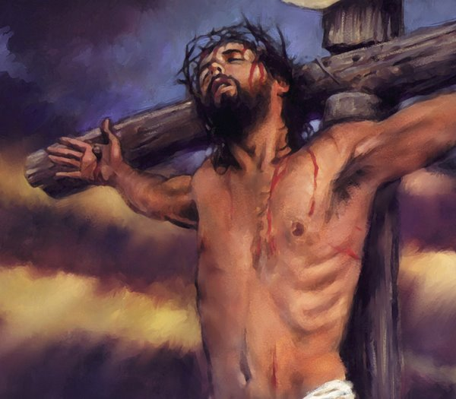
Crucifixion
And so Jesus went to his death:
  To bring all Jewry to the true knowledge of God
  And the universal acceptance of his will upon earth
  And to fulfill Scripture and the will of his Father

Slide 7
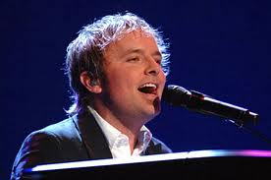
Resurrection
Triumph over sin and death.
“I will rise,” by Chris Tomlin. Flash forward moment, to modern Christianity.
Absolutely central Christian doctrine
Others
  The Last Supper
  Women
  Establishing the Church
Notes:
Women central in the discovery of the empty tomb, and given a place in ancient hierarchy not usually conferred on women.
Establishing the church during Jesus forty days of presence among apostles and other followers before the Ascencion.
And flash forward moment. The significance and influence of the past on the present. In this instance, Christ’s work on the Cross carried forward into modern Christianity.

Slide 8
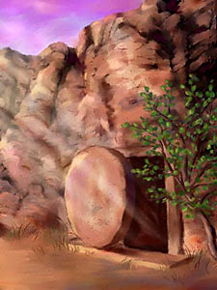
Death and History
Jesus’s death so appalling and, yet authentic, that it could not be jettisoned.
He was dead, his followers hiding, only a few bold women returned to the tomb. Then, amazingly…

Slide 9
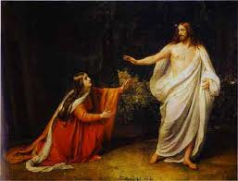
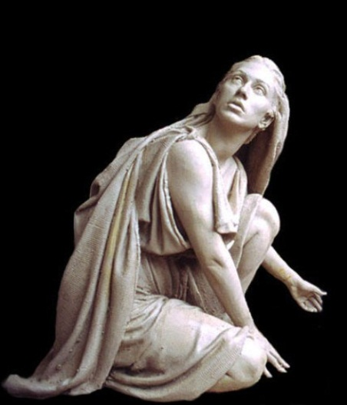
Resurrection
Jesus appears to Mary Magdalene on the third day.
The astonishing news.
He is risen

Slide 10
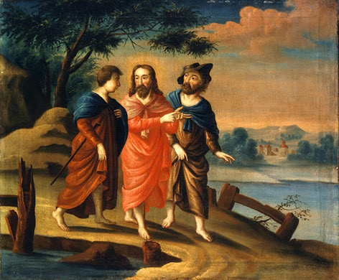
Resurrection
History or religious myth?
See Cahill. Next slide.
Jesus on road to Emmaus
Notes:
Michael Cahill wrote: “To set them down as a hoax would do a significant disservice to the teaching that surrounds them” (Cahill, 220). That helps, some. He continues, “As in the case of Jesus’ miracles, we have to imagine that most sublime moral sentiments ever expressed had somehow been drafted in the service of
of a cheap fraud. To hypothesize that the disiciples were the victims of mass hysteria would be almost problematic: Jesus appeared to groups, certainly, but first of all to individuals (who, by definition, cannot be accused of mass hysteria); and the disciples of Jesus, simple though many of them certainly were, were not notable so much for their fanciful imaginations, as for their plodding literalness—hardly the ideal ground for hysteria of any sort. It seems wisest to say that the disciples believed that they had encountered the risen Jesus, that he was looking much better than when they had last seen him…and, despite the ease with which he appeared and disappeared, he was tangible.” (pp,. 220-221)

Slide 11
Resurrection: History or Religious Myth?
Michael Cahill wrote: “To set them down as a hoax would do a significant disservice to the teaching that surrounds them” (Cahill, 220). That helps, some. He continues, “As in the case of Jesus’ miracles, we have to imagine that most sublime moral sentiments ever expressed had somehow been drafted in the service of
of a cheap fraud. To hypothesize that the disciples were the victims of mass hysteria would be almost problematic: Jesus appeared to groups, certainly, but first of all to individuals (who, by definition, cannot be accused of mass hysteria); and the disciples of Jesus, simple though many of them certainly were, were not notable so much for their fanciful imaginations, as for their plodding literalness—hardly the ideal ground for hysteria of any sort. It seems wisest to say that the disciples believed that they had encountered the risen Jesus, that he was looking much better than when they had last seen him…and, despite the ease with which he appeared and disappeared, he was tangible.” (Thomas Cahill, Desire of the Everlasting Hills: The World Before and After Jesus, pp,. 220-221

Slide 12
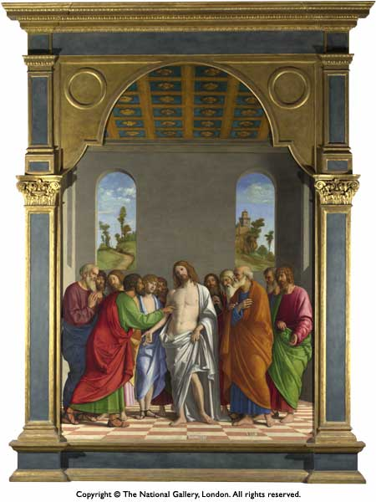
The Resurrection and Appearances
About 1502-1504, Giovanni de Battista, “The Incredulity of St. Thomas”

Slide 13
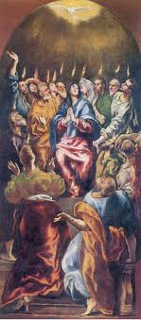
Pentecost
Apostles empowered by the Holy Spirit (Acts 2).
Tongues of fire
Speaking in tongues
Transformation of the apostles

Slide 14
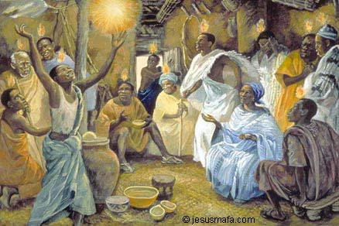
Pentecost
Flash forward moment, to modern Christianity.
Acts 2 among African Christians.
A preview of the ecumenical message of early Christianity.
For all, Jews and Gentiles

Slide 15
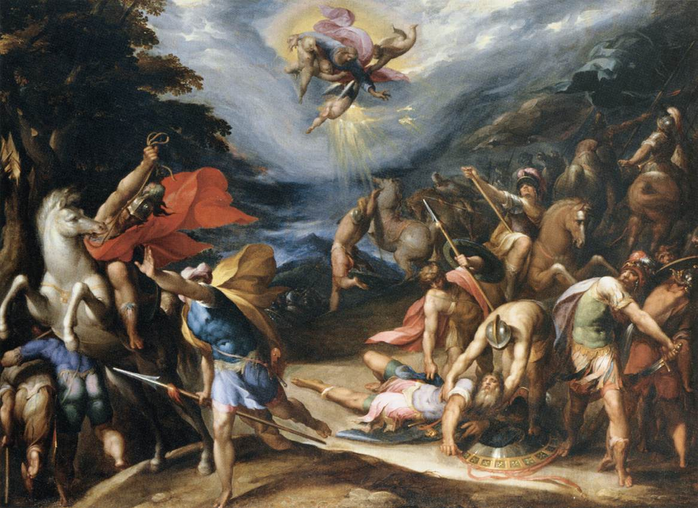
Paul, on the Road to Damascus
Notes:
The Conversion of Saint Paul on the Road to Damascus, an oil on canvas executed circa 1570-77 by the Flemish painter Hans Speckaert (c. 1540-1577). Now in the collection of the Musèe du Louvre in Paris.
The painting depicts the moment recounted in Chapter 9 of Acts of the Apostles when Saul, soon to be the apostle Paul, fell on the road to Damascus. He heard the Lord say "I am Jesus, whom you persecute, arise and go into the city."
To view a larger image of the mosaic, click on the image above

Slide 16
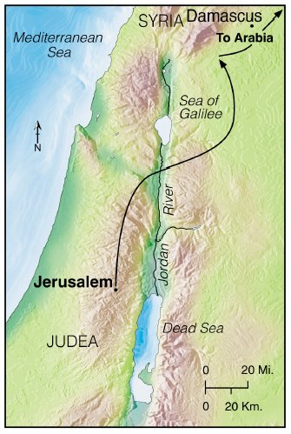
Paul Forges Christian Theology
Roman citizen, Tarsus
A Jew, “Hebrew of Hebrews”
Studied under Gamaliel, leading Pharisee (meaning “separate”)

Slide 17
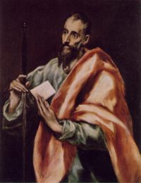
Paul Forges Christian Theology
Paul recognized “Jesus is the risen Lord,” or “Jesus is the Son of God.”
From that there flowed the new theology.
Based on the new covenant of grace, replacing the old covenant of law

Slide 18
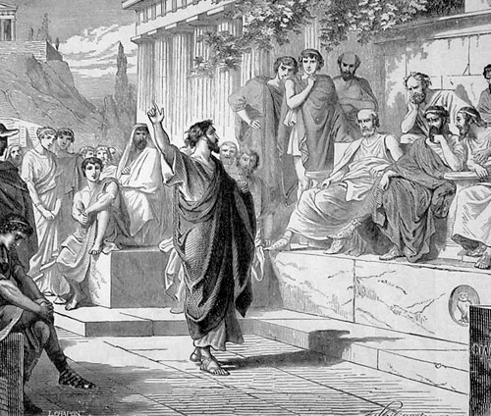
Paul Forges Christian Theology
Message for Gentiles (Greeks) as well as Jews
Some important concepts:
  Church “body” of Christ
  A Christian existence “in God”
  Vanquishing difference between Jew and Gentile

Slide 19
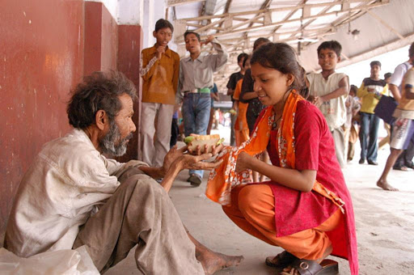
Paul Forges Christian Theology
Principles (cont.)
  Christ died for sins in accordance to Scripture
  Christ was crucified, dead, buried, and resurrected
  This message for all, Jews, Gentiles, free, slave, men, women.

Slide 20
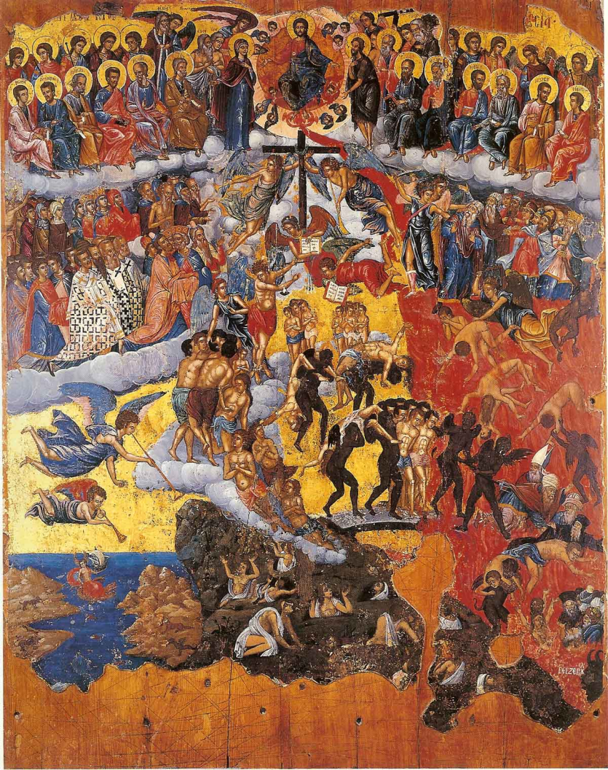
Paul Forges Christian Theology
Principles and Concepts (cont.)
  Salvation through grace by faith
  Parousia (Second Coming of Christ)
  Doctrine of the Holy Spirit (age of Spirit has succeeded age of Torah)
  Baptism in the Spirit

Slide 21
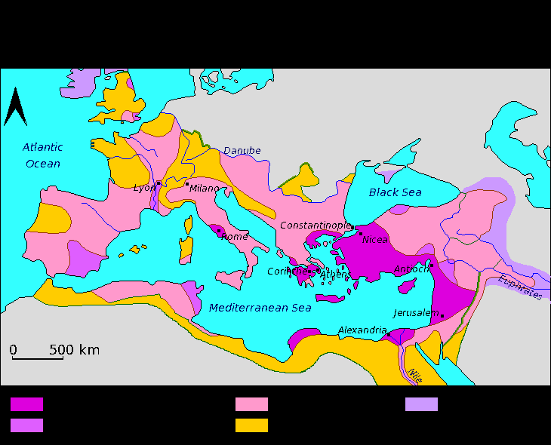
Paul Forges Christian Theology
Principles and Concepts (cont.)
  The new person
  From “darkness to light”
As Paul taught and traveled, the early Church grew.
Next Module

