Slide 1
The Life and Times of Jesus Christ
The Life and Times of Jesus Christ
Tuesday, Oct. 2, 2017
Osher Lifelong Learning Institute (OLLI)
The University of Alabama, Tuscaloosa
Larry Clayton, Instructor

Slide 2
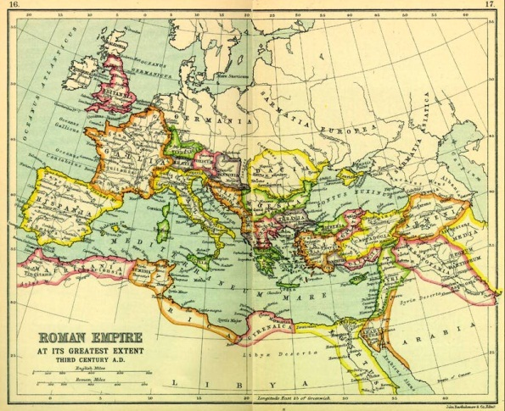
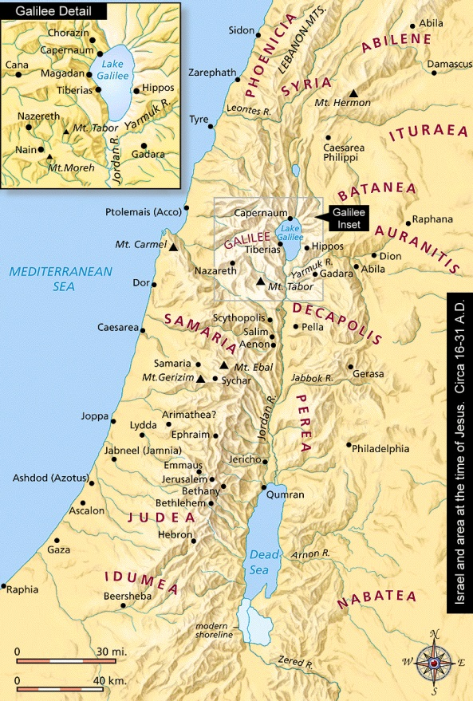
The Life and Times of Jesus Christ
Palestine under Roman rule
63 B.C.E. Roman legions commanded by Pompey conquer Judea
See next slide for short history of Israel under Roman Empire
Notes:
The history of the Jews in the Roman Empire traces the interaction of Jews and Romans during the period of the Roman Empire (27 BC – AD 476). Their cultures began to overlap in the centuries just before the Christian Era. Jews, as part of the Jewish diaspora, migrated to Rome and Roman Europe from the Land of Israel, Asia Minor, Babylon and Alexandria in response to economic hardship and incessant warfare over the land of Israel between the Ptolemaic and Seleucid empires. In Rome, Jewish communities enjoyed privileges and thrived economically, becoming a significant part of the Empire's population (perhaps as much as ten percent).^{[1]}
The Roman general Pompey in his eastern campaign established the Roman province of Syria in 64 BC and conquered Jerusalem in 63 BC. Julius Caesar conquered Alexandria c. 47 BC and defeated Pompey in 45 BC. Under Julius Caesar, Judaism was officially recognised as a legal religion, a policy followed by the first Roman emperor, Augustus. Herod the Great was designated ‘King of the Jews’ by the Roman Senate in c. 40 BC, the Roman province of Egypt was established in 30 BC, and Judea proper, Samaria and Idumea (biblical Edom) were converted to the Roman province of Iudaea in 6 AD. Jewish-Roman tensions resulted in several Jewish–Roman wars, 66-135 AD, which resulted in the destruction of Jerusalem and the Second Temple and institution of the Jewish Tax in 70 and Hadrian's attempt to create a new Roman colony named Aelia Capitolina c. 130.
Around this time, Christianity developed from Second Temple Judaism. In 313, Constantine and Licinius issued the Edict of Milan giving official recognition to Christianity as a legal religion. Constantine the Great moved the Roman capital from Rome to Constantinople (‘New Rome’) c. 330, sometimes considered the start of the Byzantine Empire, and with the Edict of Thessalonica in 380, Christianity became the state church of the Roman Empire. The Christian emperors persecuted their Jewish subjects and restricted their rights.^{[1]}

Slide 3
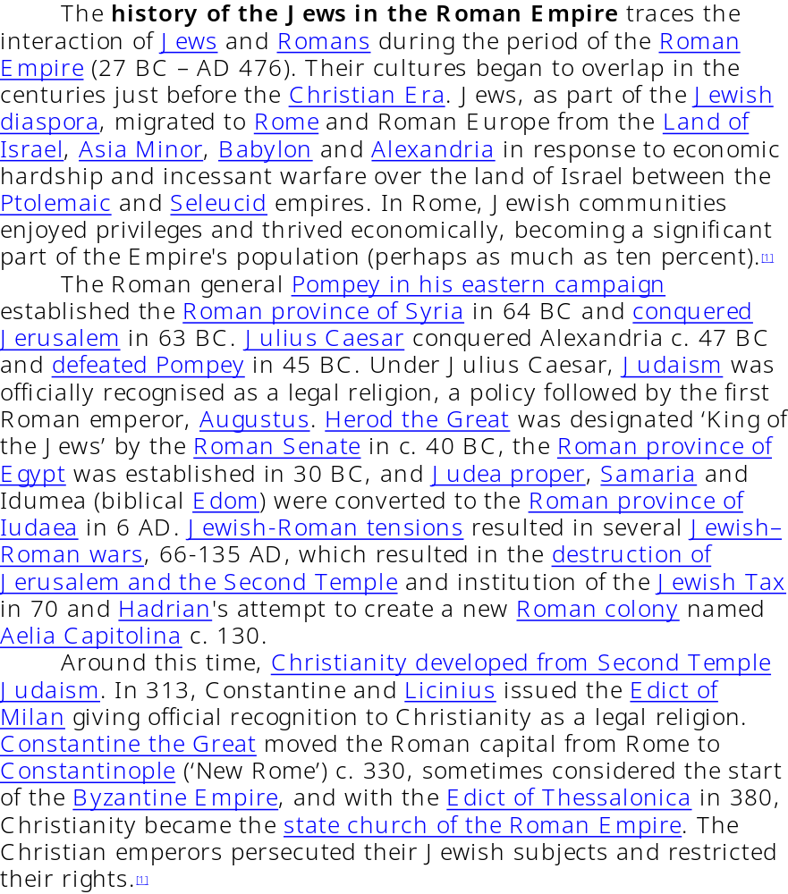
Short History of Jews in the Roman Empire

Slide 4
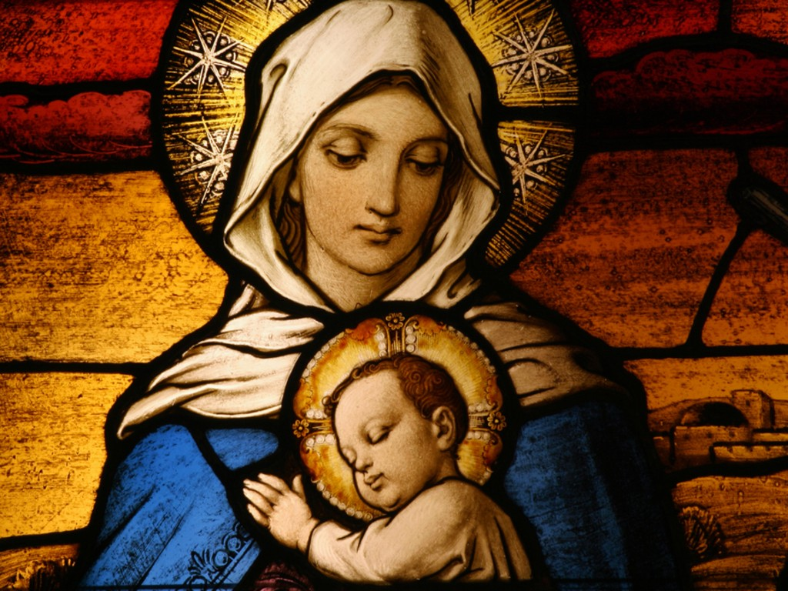
The Life and Times of Jesus Christ
Let’s do the story quickly, then return and consider the history more carefully.
Jesus born about 4 B.C.E.
Grew from boy to man in Nazareth in Galilee.
We know little of youth.
Notes:
Madonna and child from web site http://www.yoyita.com/Renaissance/Madonna_and_child_renaissance.html
The Madonna and Child is one of the central icons of Christianity. After some initial resistance and controversy, the formula "Mother of God" (Theotokos) was adopted officially by the Christian Church at the Council of Ephesus, 431. The earliest representations of Mother and Child were developed in the Eastern Empire, where despite an iconoclastic strain in culture that rejected physical representations as "idols", respect for venerated images was expressed in the repetition of a narrow range of highly conventionalized types, the repeated images familiar as icons (Greek "image").
In the West, hieratic Byzantine models were closely followed in the Early Middle Ages, but with the increased importance of the cult of the Virgin in the 12th and 13th centuries a wide variety of types developed to satisfy a flood of more intensely personal forms of piety. In the usual Gothic and Renaissance formulas the Virgin Mary sits with the Infant Jesus on her lap, or enfolded in her arms. In earlier representations the Virgin is enthroned, and the Child may be fully aware, raising his hand to offer blessing. In a 15th century Italian variation, a baby John the Baptist looks on.

Slide 5
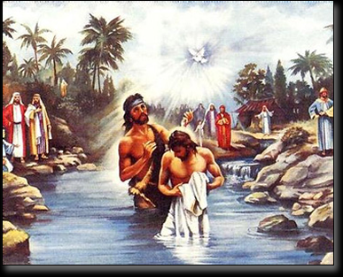
The Life and Times of Jesus Christ
Baptized by John the Baptist in River Jordan.
Began his three year ministry
Became an itinerant preacher (Rabbi)
Drew a large following.
Notes:
It was about three years before Jesus’ arrest that we first hear of John, the Baptist. According to the gospels, John was a wild man, much like the prophets of ancient Israel. He wore leather underwear and a coat of camel’s hair. He ate locusts and honey and his message, that the messiah was about to appear resonated loudly among Jews chafing under the heel of Roman rule.
The gospels claim that John was a hugely successful preacher and important people came to him for a cleansing baptism in preparation for the coming emancipation. Some of John’s disciples even claimed he was the messiah and to this day a sect called the Mandaeans in southern Iraq venerates John and regards Jesus as mšiha kdaba or the “false messiah".
Jesus was among the throngs who flocked to John. When John saw Jesus, who was reportedly his cousin, coming to be baptized he initially demurred saying that he, John, was unfit to perform the task. Some say John recognized Jesus’ godhood (even before Jesus was baptized with God’s spirit). Still, just before John was beheaded by King Herod he sent messengers asking Jesus if he was really the one they were expecting (Matt 11:3). John was uncertain even to his death because Jesus, as he did so many times throughout the gospels, would not give a definitive answer to John’s question
Jesus was among the throngs who flocked to John. When John saw Jesus, who was reportedly his cousin, coming to be baptized he initially demurred saying that he, John, was unfit to perform the task. Some say John recognized Jesus’ godhood (even before Jesus was baptized with God’s spirit). Still, just before John was beheaded by King Herod he sent messengers asking Jesus if he was really the one they were expecting (Matt 11:3). John was uncertain even to his death because Jesus, as he did so many times throughout the gospels, would not give a definitive answer to John’s question.

Slide 6
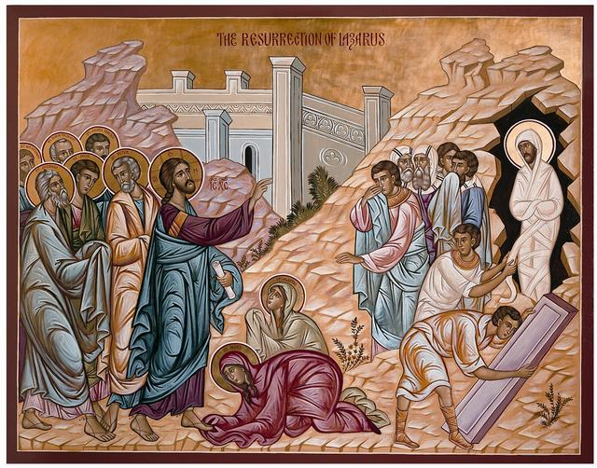
The Life and Times of Jesus Christ
Traveled through Galilee, Tyre, Sidon preaching, healing, performing miracles.
Preached that he was inaugurating the Kingdom of God
To Jerusalem at end of three years.

Slide 7
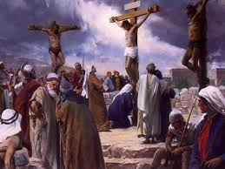
The Life and Times of Jesus Christ
Arrested and brought to trial in the administration of Roman procurator, Pontius Pilate
Condemned to die, crucified, and entombed for three days.
This was about 33 C.E., perhaps as early as 29 C.E.

Slide 8

The Life and Times of Jesus Christ
Michael Grant, An Historian’s Review of the Gospels.
“There have been countless lives of Jesus….”
Notes:
"There have been countless lives of Jesus. Moreover, they have come to extraordinarily divergent conclusions. Indeed, it has been objected that no objective life of Jesus can be written at all because our information is insufficient and cannot ever be anything else…True, a great deal is missing. Nevertheless, his public career can to a considerable extent be reconstructed. The evidence is hard, very hard, to decipher. But something substantial is there for the finding." (1,2)

Slide 9

The Life and Times of Jesus Christ
The birth narratives from Luke and Matthew.
The Annunciation (Luke 1:26-31)
Mary obedient to God.
A constant theme in rise of Christianity
Notes:
²⁶ In the sixth month of Elizabeth’s pregnancy, God sent the angel Gabriel to Nazareth, a town in Galilee, ²⁷ to a virgin pledged to be married to a man named Joseph, a descendant of David. The virgin’s name was Mary. ²⁸ The angel went to her and said, “Greetings, you who are highly favored! The Lord is with you.” ²⁹ Mary was greatly troubled at his words and wondered what kind of greeting this might be. ³⁰ But the angel said to her, “Do not be afraid, Mary; you have found favor with God. ³¹ You will conceive and give birth to a son, and you are to call him Jesus. ³² He will be great and will be called the Son of the Most High. The Lord God will give him the throne of his father David, ³³ and he will reign over Jacob’s descendants forever; his kingdom will never end.”
³⁴ “How will this be,” Mary asked the angel, “since I am a virgin?”
³⁵ The angel answered, “The Holy Spirit will come on you, and the power of the Most High will overshadow you. So the holy one to be born will be called^{[b]} the Son of God. ³⁶ Even Elizabeth your relative is going to have a child in her old age, and she who was said to be unable to conceive is in her sixth month. ³⁷ For no word from God will ever fail.”
³⁸ “I am the Lord’s servant,” Mary answered. “May your word to me be fulfilled.” Then the angel left her. (Luke 1)

Slide 10
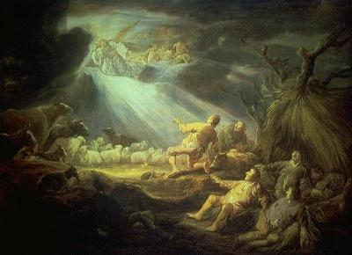
The Life and Times of Jesus Christ
Virgin birth. Why important?
Jesus born without sin, not of man but of Holy Spirit.
Important in defining divinity of Jesus.

Slide 11
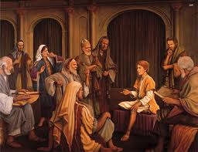
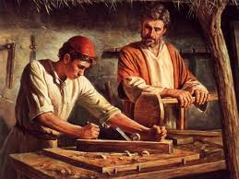
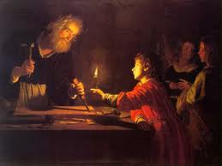
The Life and Times of Jesus Christ
Flight to Egypt (Matthew 2:13-15)
Return to Judea, but go to Nazareth in Galilee, where he grew up.
Notes:
¹³ When they had gone, an angel of the Lord appeared to Joseph in a dream. “Get up,” he said, “take the child and his mother and escape to Egypt. Stay there until I tell you, for Herod is going to search for the child to kill him.” ¹⁴ So he got up, took the child and his mother during the night and left for Egypt, ¹⁵ where he stayed until the death of Herod. And so was fulfilled what the Lord had said through the prophet: “Out of Egypt I called my son.”^{[c]}
¹⁶ When Herod realized that he had been outwitted by the Magi, he was furious, and he gave orders to kill all the boys in Bethlehem and its vicinity who were two years old and under, in accordance with the time he had learned from the Magi. ¹⁷ Then what was said through the prophet Jeremiah was fulfilled:
¹⁸ “A voice is heard in Ramah,
weeping and great mourning,
Rachel weeping for her children
and refusing to be comforted,
because they are no more.”^{[d]}
The Return to Nazareth
¹⁹ After Herod died, an angel of the Lord appeared in a dream to Joseph in Egypt ²⁰ and said, “Get up, take the child and his mother and go to the land of Israel, for those who were trying to take the child’s life are dead.” ²¹ So he got up, took the child and his mother and went to the land of Israel. ²² But when he heard that Archelaus was reigning in Judea in place of his father Herod, he was afraid to go there. Having been warned in a dream, he withdrew to the district of Galilee, ²³ and he went and lived in a town called Nazareth. So was fulfilled what was said through the prophets, that he would be called a Nazarene. (Matthew 2)

Slide 12
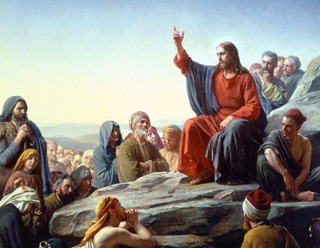
The Life and Times of Jesus Christ
The Message of Jesus
Inauguration of the Kingdom of God
Fulfilling prophecy
“It is said….”
Notes:
First things must come first: and every thought and saying of Jesus was directed and subordinated to one single thing, a difficult thing to put into words today: the realization of the Kingdom of God upon the earth.
It was customary for other devout Jews also to believe that this would eventually happen. What made Jesus unique was his conviction that it had already started happening by his agency and under his guidance. His disclosure at Nazareth that this was actually taking place here and now is described by the evangelist whom we know as Luke.
So he came to Nazareth, where he had been brought up, and went to synogogue on the Sabbath day as he regularly did. He stood up to read the lesson and was handed the scroll of the prophet Isaiah. He opened the scroll and found the passage which says, 'the spirit of the Lord is upon me because he has anointed me; he has sent me to announce good news to the poor, to proclaim release for prisoners and recover of sight for the blind; to let the broken victims go free, to proclaim the year of the Lord's favour.'
He rolled up the scroll, gave it back to the attendant, and sat down; and all eyes in the synogogue were fixed upon him.
He began to speak: 'Today,' he said, in your very hearing this text has come true.'

Slide 13
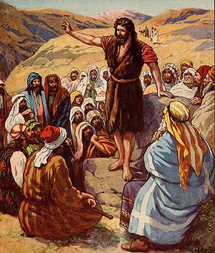
The Life and Times of Jesus Christ
Jesus ministry begins with baptism by John
John preached repentance, confession, baptism, redemption and forgiveness of sins. (see Mark 1:1-15)

Slide 14
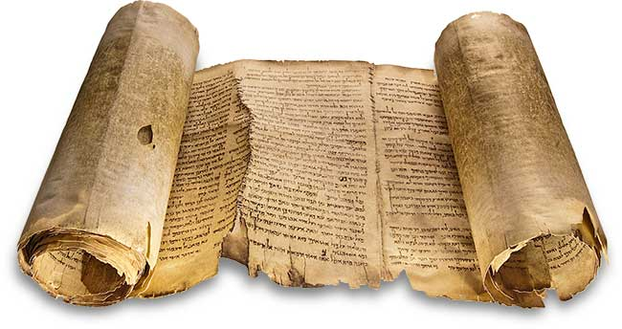
The Life and Times of Jesus Christ
John and Essene community
Dead Sea scrolls, 1947

Slide 15
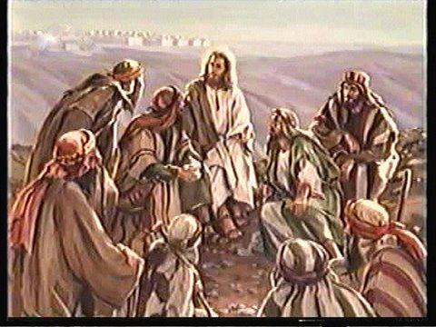
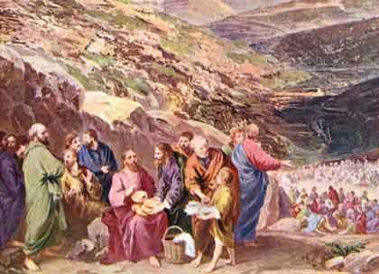
The Life and Times of Jesus Christ
Jesus teaches:
  Repentance
  Ushering in the Kingdom of God, and
  Preached to all, including sinners

Slide 16
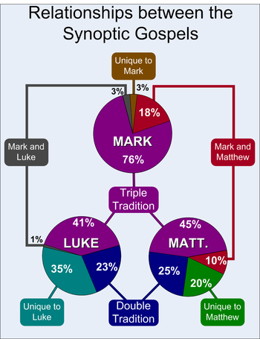
The Life and Times of Jesus Christ
Now, for some history
Gospels as basic sources of the historical Jesus
Synopic gospels, and John

Slide 17
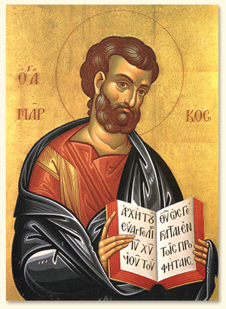
The Life and Times of Jesus Christ
Matthew, the tax collector, directed his Gospel to the Jews, wrote in Hebrew
Luke, the doctor, directed his to the Gentiles, wrote in Greek
Mark, the first gospel (63-70 CE), straightforward

Slide 18
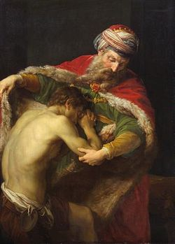
The Life and Times of Jesus Christ
Jesus taught in parables.
Absolute basic message, love one another.
See Sermon on the Mount, Matthew 5
Jesus reiterates Jewish law but pushes for a change of heart, a born again experience.

Slide 19
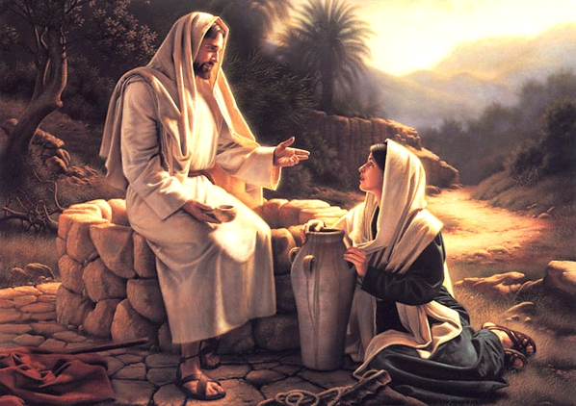
The Life and Times of Jesus Christ
Jesus the man
Liked to enjoy himself
Sought company of others
Enjoyed eating, drinking
Good sense of humor
Consorted with women
With outcasts, lepers, tax collectors

Slide 20
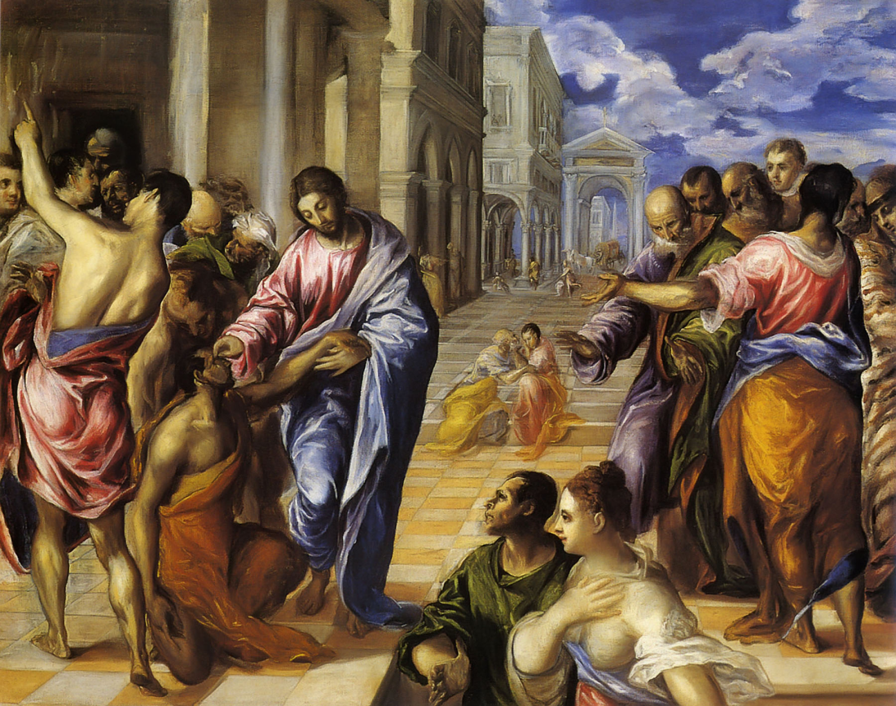
The Life and Times of Jesus Christ
The kingdom of God also meant:
Healing
Miracles
Casting out spirits
A new code of rule between Jews and their God, which stressed grace rather than law.
Notes:
Healing the blind, El Greco

Slide 21
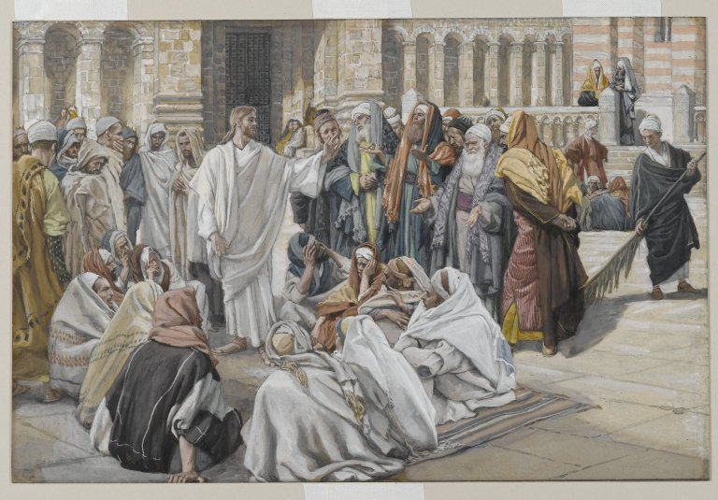
The Life and Times of Jesus Christ
And this new code undermined the authority of Jewish leaders.
Pharisees, Sadducees, Scribes, combined to destroy Jesus.
Tune in to Module Three for what happened!

